Slide 1
Lesson IV
Integrity of the Christian Leader
Purpose and outcome of Integrity and our commitment for evangelism

Slide 2
World Evangelisation
But perhaps the greatest hindrance to world evangelization remains our failure to be what we profess to be. The covenant still challenges us to look like what we are talking about: "Nothing commends the Gospel more eloquently than a transformed life, and nothing brings it into disrepute so much as personal inconsistency"
- Manila Manifesto

Slide 3
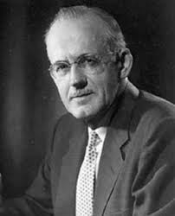
"The church at this moment needs men who feel themselves expendable in the warfare of the soul. Such men will be free from the compulsions that control weaker men : the lust of the eyes, the lust of the flesh, the pride of life.
They will not be forced to do things by the squeeze of circumstances. Their only compulsion will
come from within and from above.
This kind of freedom is necessary if we are
going to have prophets in our pulpits again
instead of mascots…

Slide 4
…These free men will serve God and man from motives too high to be understood by the rank and file, who today shuffle in and out of the sanctuary.
They will make no decision out of fear, they will take no course out of a desire to please, accept no service for financial consideration. They will perform no religious act out of mere custom. Nor will
they allow themselves to be influenced by
the love of publicity, or by the desire for
reputation.“ - AW Tozer

Slide 5
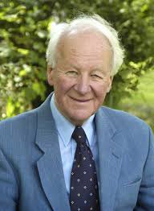
It is sheer hypocrisy to raise our eyebrows, shrug our shoulders and wring our hands. The Lord Jesus told us to be the world’s salt and light.
If therefore rottenness and darkness abound around us, it is our fault and we must accept the blame.
DR. JOHN STOTT

Slide 6
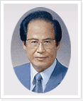
To a large extent, social transformation has been brought about, not by revolutionaries but by true believers, who with their detachment from the mundane world, endeavoured to realize God's will on earth.
-Dr. Won Sul Lee

Slide 7


Slide 8
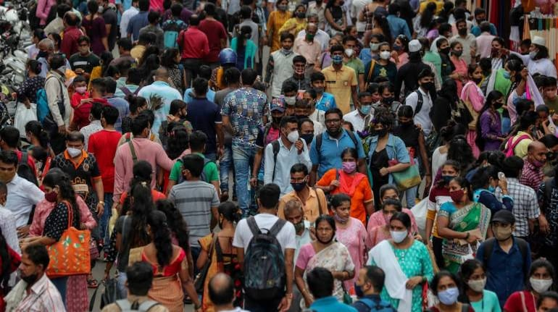

Slide 9

I choose to be
an Ambassador for Christ
even if it requires me to
lay down my life for Him.
Notes:
We are Ambassadors for Christ. II Cor 5:18-20 / Jn 12:24-25

Slide 10
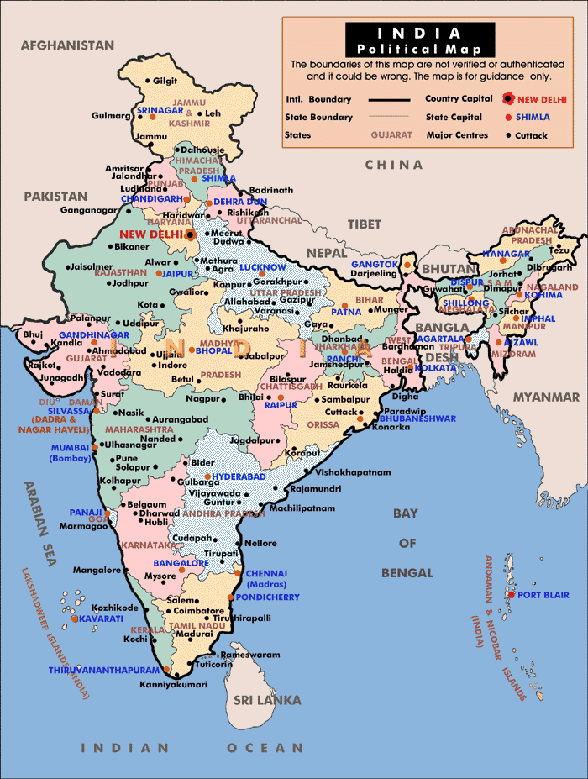
For God to heal India
healing has to begin with me.

