Slide 1
Lesson III
Integrity of the Christian Leader
Integrity in terms of Possession & Passion

Slide 2

Notes:
1Ch 28:9 "As for you, my son Solomon, know the God of your father, and serve Him with a loyal heart and with a willing mind; for the LORD searches all hearts and understands all the intent of the thoughts. If you seek Him, He will be found by you; but if you forsake Him, He will cast you off forever.
Gen 22:1-2 Now it came to pass after these things that God tested Abraham, and said to him, "Abraham!" And he said, "Here I am." (2) Then He said, "Take now your son, your only son Isaac, whom you love, and go to the land of Moriah, and offer him there as a burnt offering on one of the mountains of which I shall tell you."

Slide 3

Notes:
The staggered creation of God – What is man’s habitat? God is man’s habitat - Act 17:28-31 for in Him we live and move and have our being, as also some of your own poets have said, 'For we are also His offspring.' (29) Therefore, since we are the offspring of God, we ought not to think that the Divine Nature is like gold or silver or stone, something shaped by art and man's devising. (30) Truly, these times of ignorance God overlooked, but now commands all men everywhere to repent, (31) because He has appointed a day on which He will judge the world in righteousness by the Man whom He has ordained. He has given assurance of this to all by raising Him from the dead.“
Col 1:16-17

Slide 4
The creation narrative
Form
Filling
Light
Firmament
  Sky
  Sea
Dry land/Vegetation
Light bearers
Inhabitants
  Birds
  Fish
Land animals / Human beings

Slide 5


Slide 6
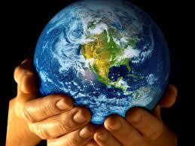
Man as a Regent/Viceroy over
God’s creation
Notes:
Gen 1:26 Then God said, "Let Us make man in Our image, according to Our likeness; let them have dominion over the fish of the sea, over the birds of the air, and over the cattle, over all the earth and over every creeping thing that creeps on the earth."
Psa 8:3-6 When I consider Your heavens, the work of Your fingers, The moon and the stars, which You have ordained, (4) What is man that You are mindful of him, And the son of man that You visit him? (5) For You have made him a little lower than the angels, And You have crowned him with glory and honor. (6) You have made him to have dominion over the works of Your hands; You have put all things under his feet,

Slide 7
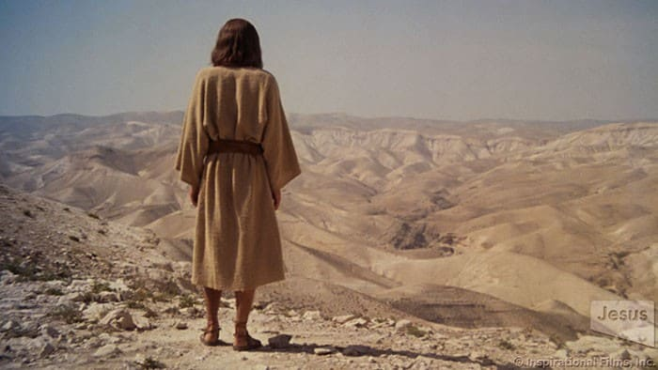
What was the trap of the Devil? - Matt 4:1-4
Live based on securing the essentials of life (bread) and not on the will of God (Word)
Notes:
Deu 8:2-3 And you shall remember that the LORD your God led you all the way these forty years in the wilderness, to humble you and test you, to know what was in your heart, whether you would keep His commandments or not. (3) So He humbled you, allowed you to hunger, and fed you with manna which you did not know nor did your fathers know, that He might make you know that man shall not live by bread alone; but man lives by every word that proceeds from the mouth of the LORD.

Slide 8


Choices in life have two options

Slide 9
Choices in life must always be His will

Slide 10

Choices that we make in life, reveal the motives of the heart

Slide 11
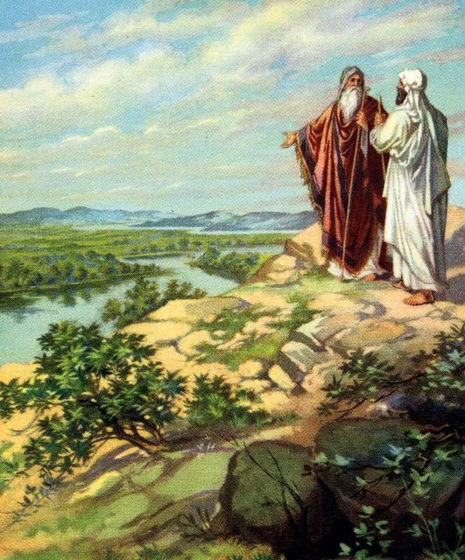
The choices of Abraham & Lot.

Slide 12
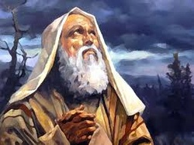
And God gave him no inheritance in it, not even enough to set his foot on

Slide 13
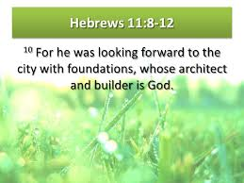

Slide 14
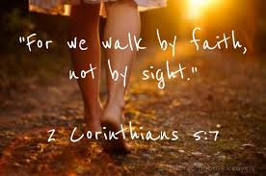

Slide 15
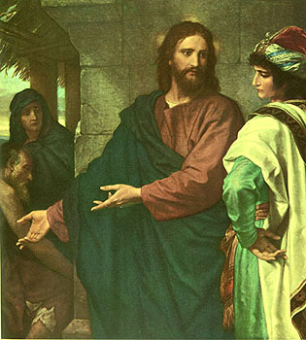
The Rich Young Ruler
Man rejects God and chooses the material instead
Notes:
Mar 10:17-27 Now as He was going out on the road, one came running, knelt before Him, and asked Him, "Good Teacher, what shall I do that I may inherit eternal life?" (18) So Jesus said to him, "Why do you call Me good? No one is good but One, that is, God. (19) You know the commandments: 'DO NOT COMMIT ADULTERY,' 'DO NOT MURDER,' 'DO NOT STEAL,' 'DO NOT BEAR FALSE WITNESS,' 'Do not defraud,' 'HONOR YOUR FATHER AND YOUR MOTHER.'" (20) And he answered and said to Him, "Teacher, all these things I have kept from my youth." (21) Then Jesus, looking at him, loved him, and said to him, "One thing you lack: Go your way, sell whatever you have and give to the poor, and you will have treasure in heaven; and come, take up the cross, and follow Me." (22) But he was sad at this word, and went away sorrowful, for he had great possessions. (23) Then Jesus looked around and said to His disciples, "How hard it is for those who have riches to enter the kingdom of God!" (24) And the disciples were astonished at His words. But Jesus answered again and said to them, "Children, how hard it is for those who trust in riches to enter the kingdom of God! (25) It is easier for a camel to go through the eye of a needle than for a rich man to enter the kingdom of God." (26) And they were greatly astonished, saying among themselves, "Who then can be saved?" (27) But Jesus looked at them and said, "With men it is impossible, but not with God; for with God all things are possible."

Slide 16
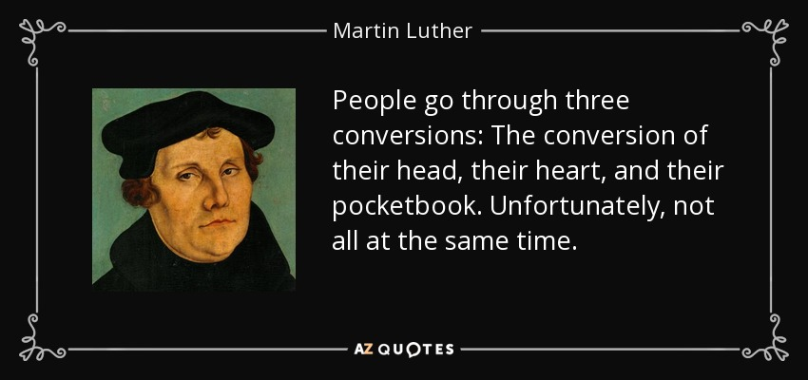

Slide 17
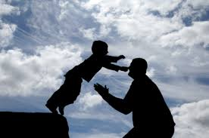
Repentance needs to be at the level of TRUST in His Word
Notes:
Mar 1:14-15 Now after John was put in prison, Jesus came to Galilee, preaching the gospel of the kingdom of God, (15) and saying, "The time is fulfilled, and the kingdom of God is at hand. Repent, and believe in the gospel."

Slide 18
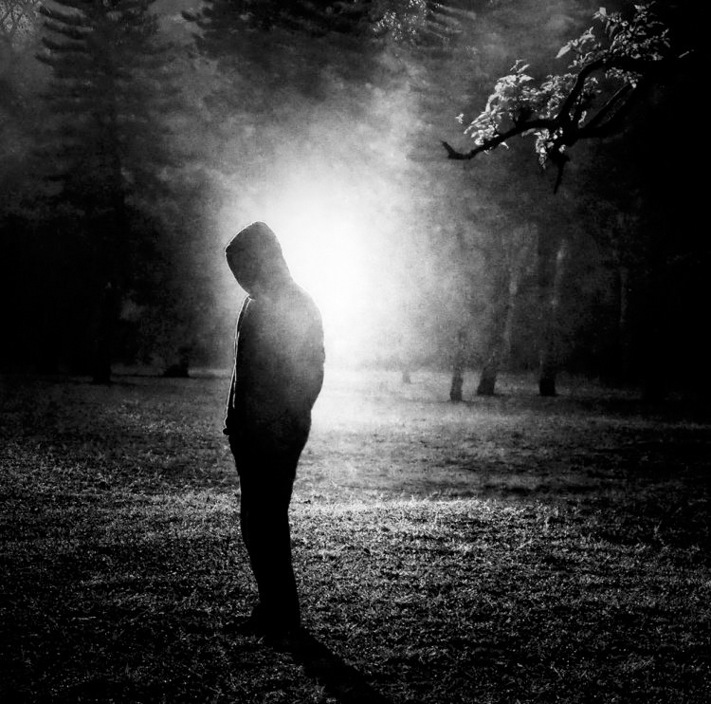
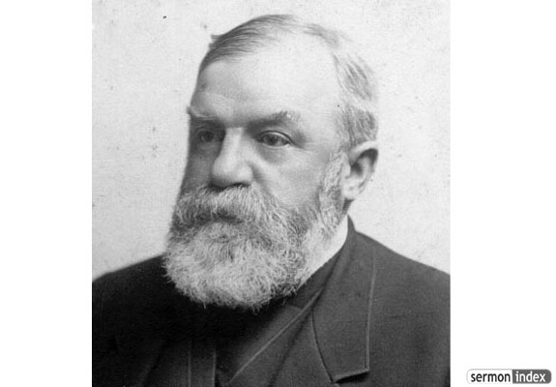
Character
CHARACTER IS
WHO YOU ARE IN THE DARK

Slide 19

The covenant relationship of marriage
Notes:
Hos 2:16 "And it shall be, in that day," Says the LORD, "That you will call Me 'My Husband,' And no longer call Me 'My Master,'
Hos 2:18-19 In that day I will make a covenant for them With the beasts of the field, With the birds of the air, And with the creeping things of the ground. Bow and sword of battle I will shatter from the earth, To make them lie down safely. (19) "I will betroth you to Me forever; Yes, I will betroth you to Me In righteousness and justice, In lovingkindness and mercy;
Isa 54:5 For your Maker is your husband, The LORD of hosts is His name; And your Redeemer is the Holy One of Israel; He is called the God of the whole earth.

Slide 20
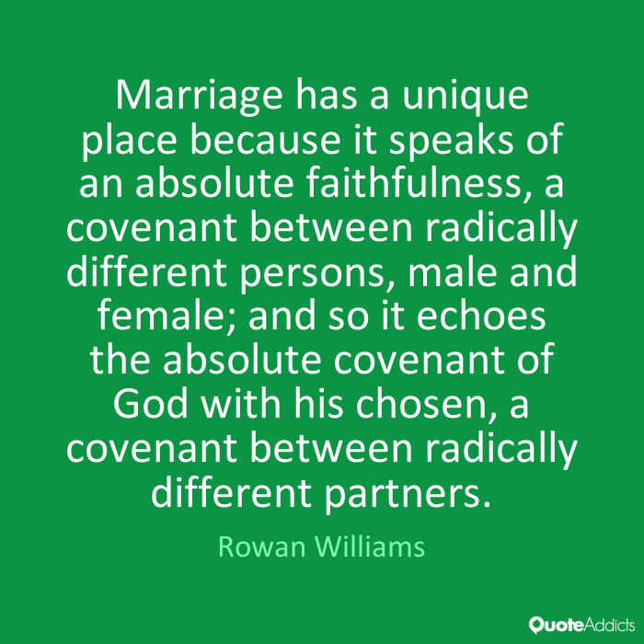
Why did God give us sexuality in marriage?
Hos 2:14-16, 19-20; Is 54:5; Jer 3:14; II Cor 11:2; Eph 5:25-27; Heb 13:4; Gen 2:24; I Cor 6:9; Eph 5:5; Col 3:5-6; I Thess 4:3; I Cor 7:2; Rev 19:7

Slide 21
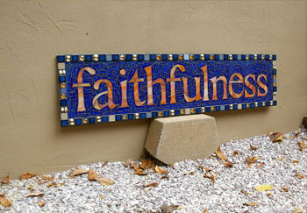
In this covenant relationship, what was God’s expectation from His people?

Slide 22
The victory of Joseph
Principle 1: The fear of the Lord
Principle 2: The fear of the Lord enables us to define the limits of a relationship
Principle 3: The fear of the Lord enables us to maintain a safe distance
Principle 4: The fear of the Lord strengthens us against persuasion to commit sexual sin
Principle 5: The fear of the Lord enables us to flee from sexual sin

Slide 23
The defeat of King David
Principle 1: We are stewards of God of our body, of our eyes and our mind
Principle 2: Adultery took place within King David.
Principle 3: Heed the warning bells
Principle 4: I cannot fight and win over temptation by my own effort
Principle 5: Yield to His Spirit and continuous surrender

Slide 24
Physical dimension
Be focused on your God given task
Never linger around sin
Never pursue after sin
Heed the warning bells
Flee from a strong physical temptation
If sin has occurred, then confess and forsake it
…

