Slide 1

Lesson II
Integrity of the Christian Leader
God’s process of building Integrity - 1

Slide 2
Learning Objectives
God’s method of building Integrity through Integrity Checks
Understanding the power of powerlessness

Slide 3
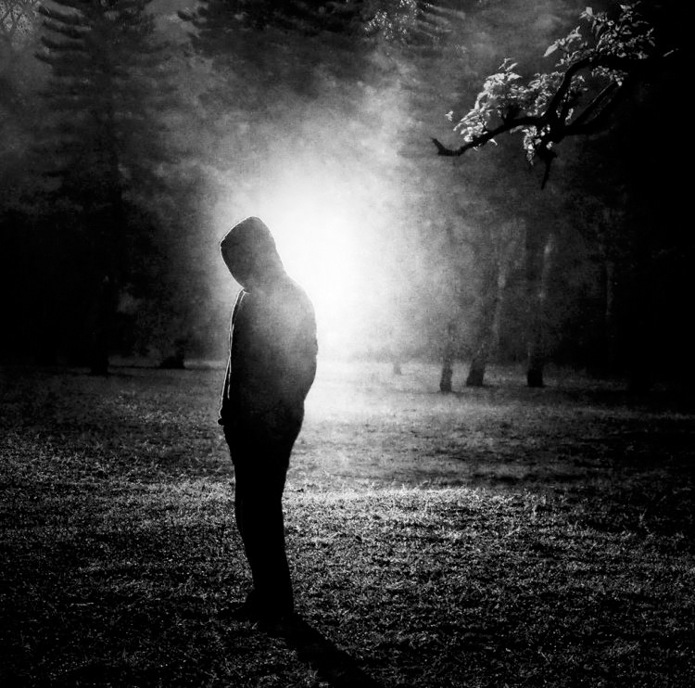
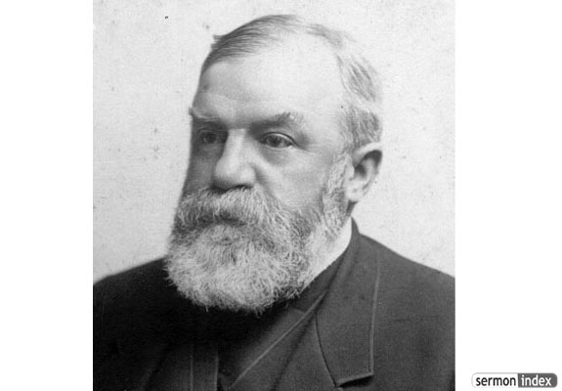
Character
CHARACTER IS
WHO YOU ARE IN THE DARK

Slide 4
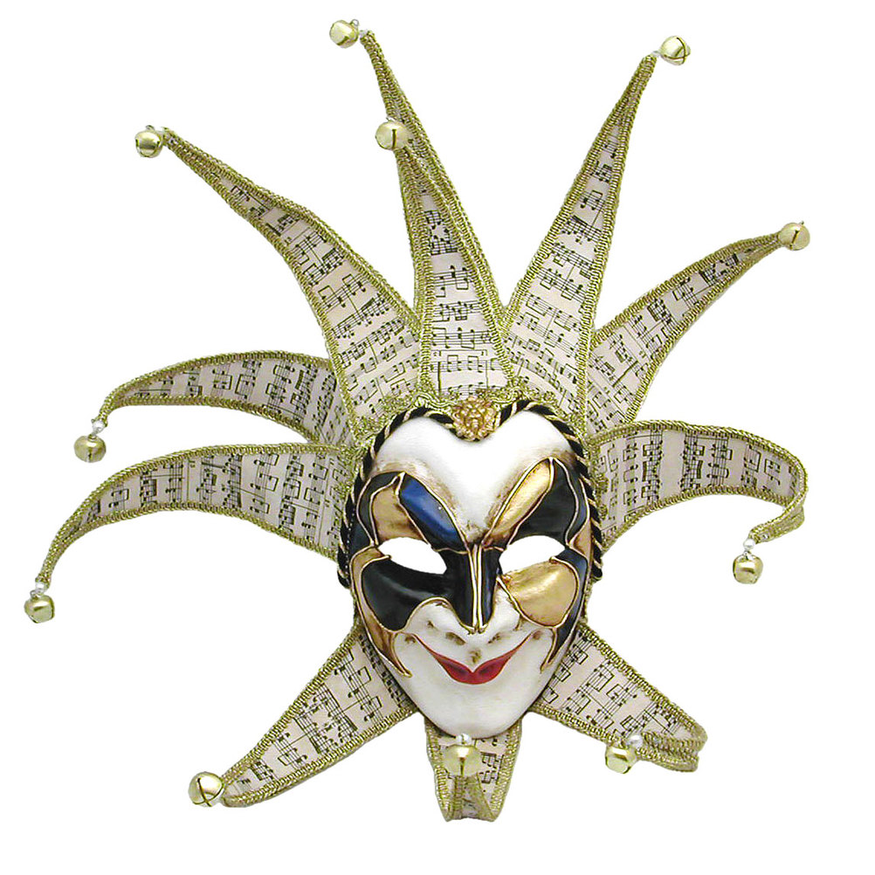
Ministry effectiveness
Effective ministry flows out of character and not out of external activity alone

Slide 5

Integrity Checks
Integrity checks
are God’s building blocks in a leader’s development and growth
Notes:
Psa 66:10-12 For You, O God, have tested us; You have refined us as silver is refined. (11) You brought us into the net; You laid affliction on our backs. (12) You have caused men to ride over our heads; We went through fire and through water; But You brought us out to rich fulfillment.
Jas 1:2-4 My brethren, count it all joy when you fall into various trials, (3) knowing that the testing of your faith produces patience. (4) But let patience have its perfect work, that you may be perfect and complete, lacking nothing.
1Pe 1:6-7 In this you greatly rejoice, though now for a little while, if need be, you have been grieved by various trials, (7) that the genuineness of your faith, being much more precious than gold that perishes, though it is tested by fire, may be found to praise, honor, and glory at the revelation of Jesus Christ,

Slide 6
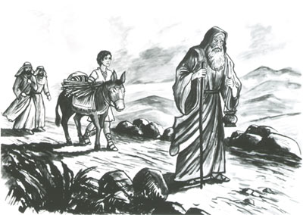
Notes:
Gen 22:1-2 Now it came to pass after these things that God tested Abraham, and said to him, "Abraham!" And he said, "Here I am." (2) Then He said, "Take now your son, your only son Isaac, whom you love, and go to the land of Moriah, and offer him there as a burnt offering on one of the mountains of which I shall tell you."
Gen 22:5 And Abraham said to his young men, "Stay here with the donkey; the lad and I will go yonder and worship, and we will come back to you.“
Heb 11:17-19 By faith Abraham, when he was tested, offered up Isaac, and he who had received the promises offered up his only begotten son, (18) of whom it was said, "IN ISAAC YOUR SEED SHALL BE CALLED," (19) concluding that God was able to raise him up, even from the dead, from which he also received him in a figurative sense.

Slide 7
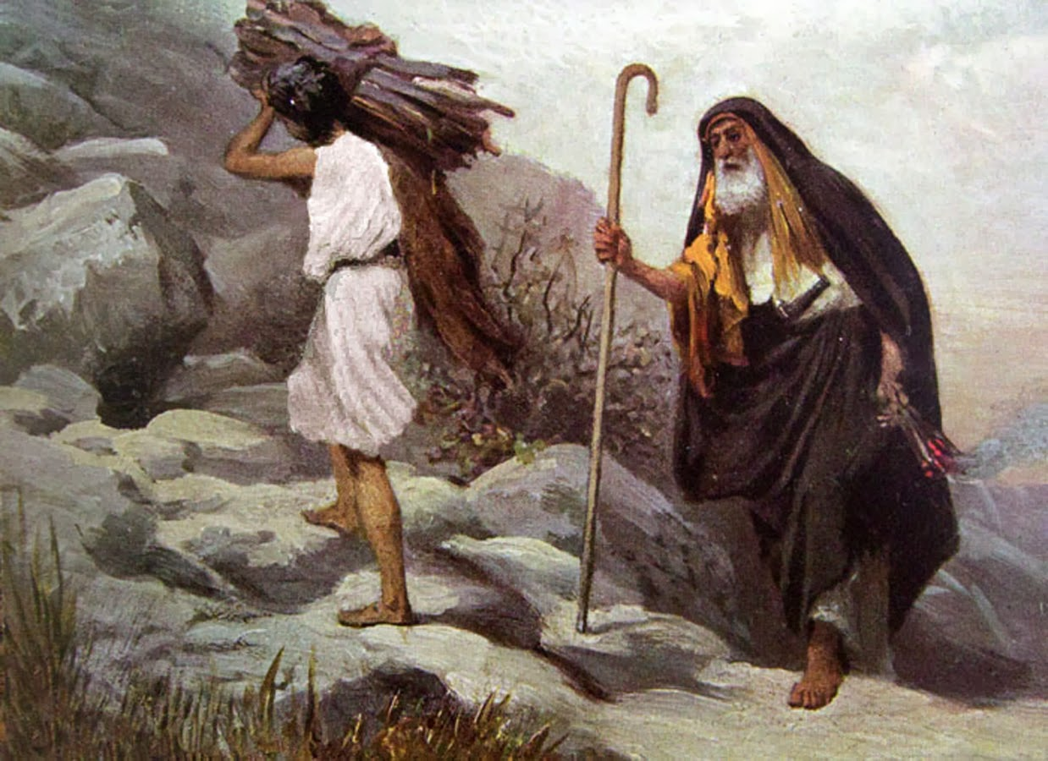
Notes:
Gen 22:6-8 So Abraham took the wood of the burnt offering and laid it on Isaac his son; and he took the fire in his hand, and a knife, and the two of them went together. (7) But Isaac spoke to Abraham his father and said, "My father!" And he said, "Here I am, my son." Then he said, "Look, the fire and the wood, but where is the lamb for a burnt offering?" (8) And Abraham said, "My son, God will provide for Himself the lamb for a burnt offering." So the two of them went together.
2Co 5:21 For He made Him who knew no sin to be sin for us, that we might become the righteousness of God in Him.

Slide 8
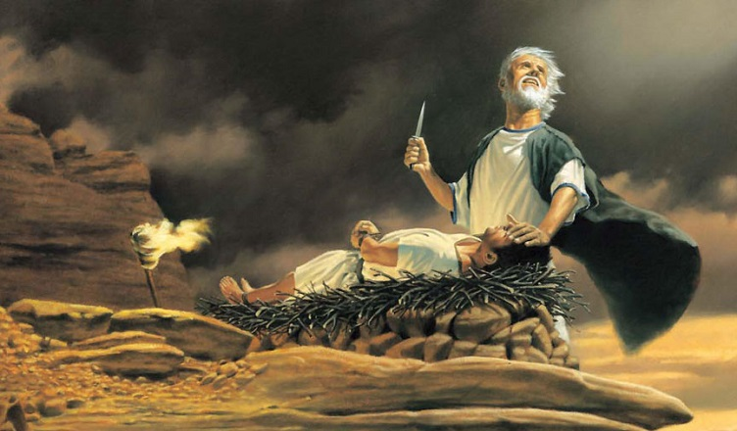
Notes:
Gen 22:10-12 And Abraham stretched out his hand and took the knife to slay his son. (11) But the Angel of the LORD called to him from heaven and said, "Abraham, Abraham!" So he said, "Here I am." (12) And He said, "Do not lay your hand on the lad, or do anything to him; for now I know that you fear God, since you have not withheld your son, your only son, from Me."
Luk 14:33 So likewise, whoever of you does not forsake all that he has cannot be My disciple.

Slide 9


Slide 10
Christian Journey
Integrity Check
Opportunity to Choose
Obedience
Maturity
Widening Influence
Participate in God’s Grand Narrative
Maturity Crucible
Maturity Cycle
Notes:
Gen 22:18 In your seed all the nations of the earth shall be blessed, because you have obeyed My voice.“
Gal 3:8-9 And the Scripture, foreseeing that God would justify the Gentiles by faith, preached the gospel to Abraham beforehand, saying, "In you all the nations shall be blessed." (9) So then those who are of faith are blessed with believing Abraham.

Slide 11


Power of the powerless
(Mat 18:3) and said, "Assuredly, I say to you, unless you are converted and become as little children, you will by no means enter the kingdom of heaven.

Slide 12
Dethroning self
enthroning Christ
CHRIST
EGO

Slide 13

SIN

Slide 14

Self enthroned
EGO
Notes:
Man cannot set himself right by his own effort. The reason is that in the heart of man another law is now in effect. The law of sin and death – Rom 7:23-24.
Rom 7:18-19 For I know that in me (that is, in my flesh) nothing good dwells; for to will is present with me, but how to perform what is good I do not find. (19) For the good that I will to do, I do not do; but the evil I will not to do, that I practice.

Slide 15
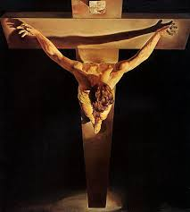
II Corinthians 5:15 and He died for all, that those who live should live no longer for themselves, but for Him who died for them and rose again.

Slide 16
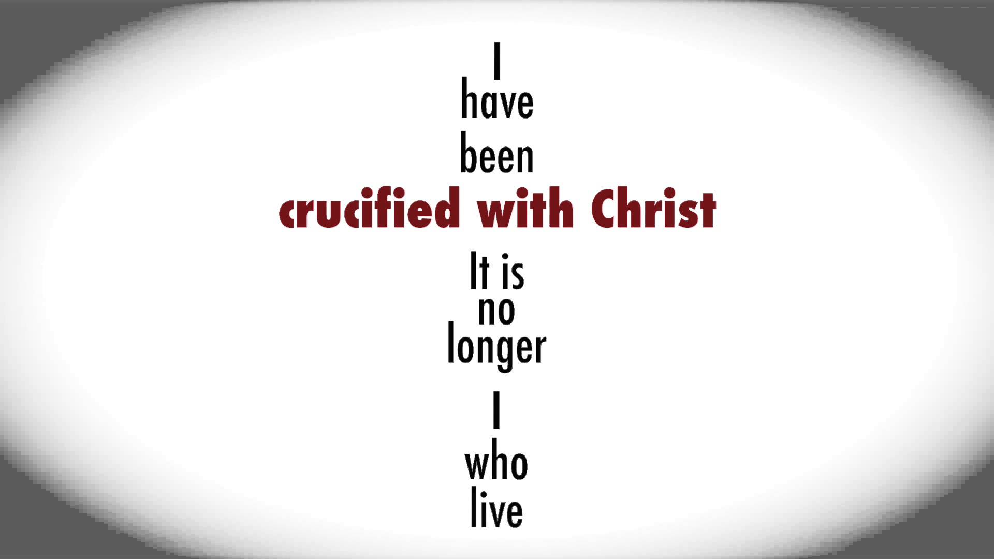
Notes:
The solution is only one. Gal 2:20 / II Cor 4:10 / Col 3:3
2Ti 2:11 This is a faithful saying: For if we died with Him, We shall also live with Him.

Slide 17
Ego Symptoms
Unwillingness to submit to authority
Victim mentality
Poor team worker
Assigning my motives to other’s action
Highly critical/ Being judgemental
Blaming others strengths / weakness for my inaction
Unwilling to say, “I’m sorry”
Chronic worrying
Unforgiving
...
Comparative/Competitive thinking
Fear of rejection/seeking acceptance
Win - lose mentality
Poor listener
Defensive
Complaining
Cynical
No vision
Insecure
Autobiographical mindset
Seeking commendation from people
Pursuing ‘my’ dreams
Pushing my agenda
Notes:
These are the usual ego challenges that we face in life. This is not an exhaustive list but a sample of the issues.
We must pray that the Holy Spirit will alert us

Slide 18

Powerlessness and the power of the Gospel
Genuinely others concerned
Ego at the foot
of the cross
Notes:
I Thess 2:4-12

Slide 19


Slide 20
Stimulus Response Interface
Flesh
Stimulus
Space
Response
Holy Spirit
In God’s response through us, lies our freedom,
growth, development and responsiveness to others

Slide 21
Responding to stimulus
Stimulus
Space
Response
Dying with Christ and God the Holy Spirit empowers us
to choose God’s response
In God’s response through us, lies our freedom,
growth, development and responsiveness to others
Notes:
8
Rom 8:2-4 For the law of the Spirit of life in Christ Jesus has made me free from the law of sin and death. (3) For what the law could not do in that it was weak through the flesh, God did by sending His own Son in the likeness of sinful flesh, on account of sin: He condemned sin in the flesh, (4) that the righteous requirement of the law might be fulfilled in us who do not walk according to the flesh but according to the Spirit.

Slide 22
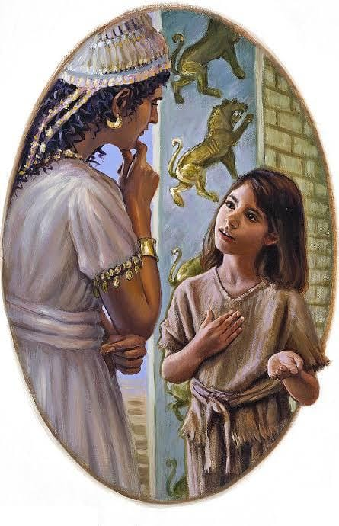
Leadership and evangelism of the
servant girl
Notes:
2Ki 5:1-5 Now Naaman, commander of the army of the king of Syria, was a great and honorable man in the eyes of his master, because by him the LORD had given victory to Syria. He was also a mighty man of valor, but a leper. (2) And the Syrians had gone out on raids, and had brought back captive a young girl from the land of Israel. She waited on Naaman's wife. (3) Then she said to her mistress, "If only my master were with the prophet who is in Samaria! For he would heal him of his leprosy." (4) And Naaman went in and told his master, saying, "Thus and thus said the girl who is from the land of Israel." (5) Then the king of Syria said, "Go now, and I will send a letter to the king of Israel." So he departed and took with him ten talents of silver, six thousand shekels of gold, and ten changes of clothing.

Slide 23
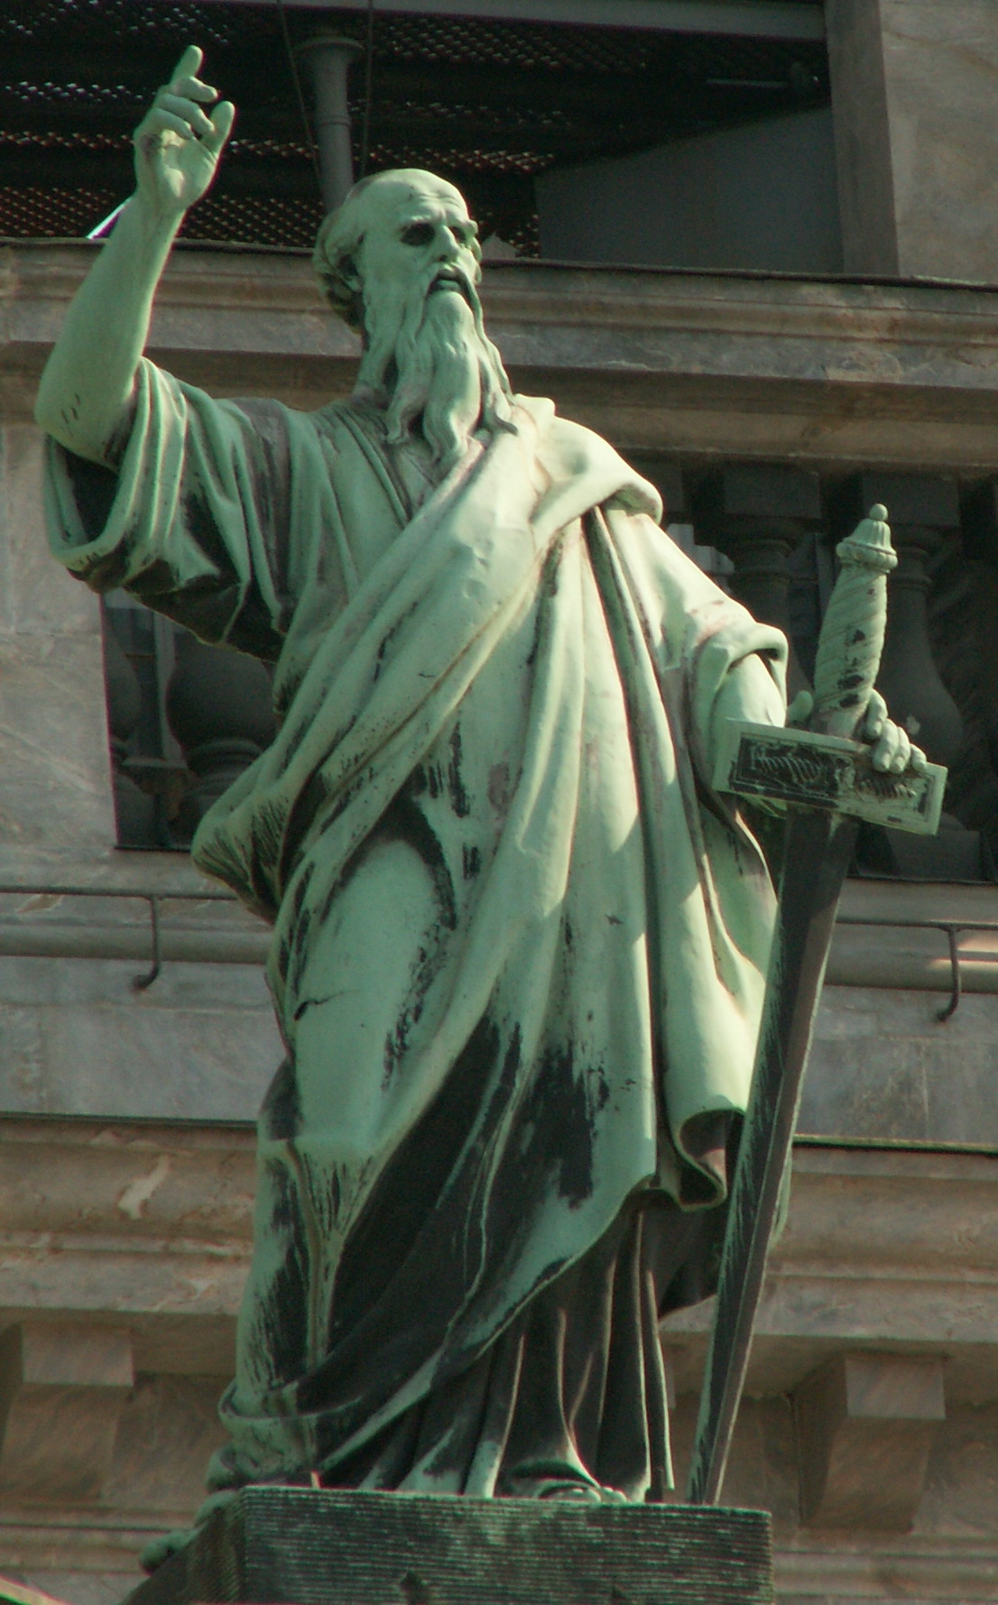
Paul’s Mission Model
Spoke not as pleasing man, but God, who tests hearts
Did not flatter
Did not put on a mask to cover up greed
Did not seek glory from men
He was gentle as a nursing mother, cherishing her children
He was prepared not only to share the gospel, but also his life
He laboured and toiled for the people
He exhorted, comforted and charged as a father does to his children

Slide 24
Impact of Paul & the team for God’s Kingdom
Model I
Paul & his team
Model III
Macedonians & Achians
Everyplace
Model II
Thessalonians

