Slide 1

Integrity of the Christian Leader
Valentine Davidar

Slide 2
Objectives for
Integrity of the Leader for Evangelising
At the end of the module, the participants will be able to:
Explain God’s mandate of Integrity in our lives.
Reaffirm the biblical concepts of integrity in terms of Power, Possessions & Passion.
Identify and bridge the‘Integrity’ gaps in one’s own life.
Prayerfully, draft an action plan to fulfil the mandate for Integrity and effective evangelism in one’s life.

Slide 3
Outcome of the course
Participants will be a leaders
committed to live by Biblical values
in all situations and thereby be effective witnesses for others to be led to Christ.

Slide 4
Lesson – I
Integrity of the Leader for evangelising
God’s mandate for Integrity in our lives for evangelising

Slide 5









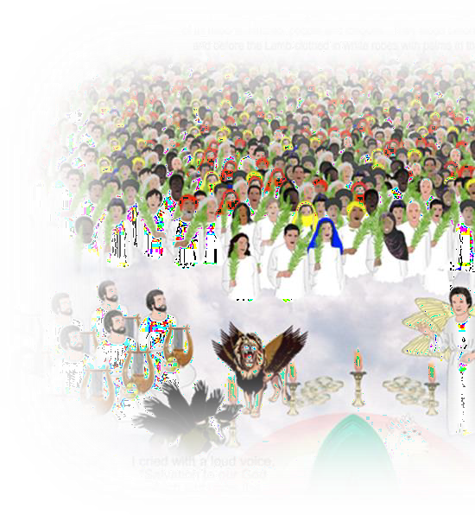

















































































AT THE FULFILLMENT OF HISTORY,
THE DWELLING OF GOD
WITH HIS PEOPLE FROM EVERY TRIBE ,
NATION, PEOPLE & LANGUAGE Rev 7: 9-17; 21: 3
IN THE BEGINNING, GOD…
THE LONG ARC OF GOD’S STORY
GOD ENTERS HUMAN
HISTORY IN
JESUS CHRIST
STORY OF GOD’S PEOPLE
PART I
GOD CALLS
STORY
Announces His Kingdom
OF GOD’S
TOWER OF BABEL
Gen 11:1-9
A kingdom of
Jn 1:14;
Gal 4:4
Mk 1:15
Is 42:1-8
Is 48: 6b
Is 61
ABRAHAM
PEOPLE PART II ABRAHAM’S SEED & HEIRS Rom 4:13,16-17
Gal 3: 6-9,14,29
_{Gen 12:1-3} priests and a holy
THE WORLDWIDE SPREAD
OF THE CHURCH
nation Ex 19:6
Gospel preached in advance to Abraham
FLOOD
THE SPREAD
OF SIN Gen 6:13-
Royal priesthood And holy nation called to disciple the nations
1 Pet 2:9, Mt 28:18-20
Rev 11:15
(Gal 3:8)
ADVANCING
THE KINGDOM OF GOD
Gen 6:5-7
Chap 9
FALL
Gen 3
11-12
CREATION
Gen 1-2

Slide 6
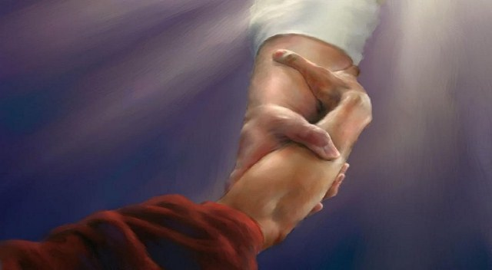
God is reconciling the world to Himself

Slide 7


Slide 8


We are either stepping stones or stumbling blocks for people to be reconciled with God

Slide 9
What is Integrity?
Wholeness, Completeness, Oneness

Slide 10

Psychologist view of the human personality

Slide 11

Notes:
1Sa 16:7 But the LORD said to Samuel, "Do not look at his appearance or at his physical stature, because I have refused him. For the LORD does not see as man sees; for man looks at the outward appearance, but the LORD looks at the heart."

Slide 12

Notes:
1Ch 28:9 "As for you, my son Solomon, know the God of your father, and serve Him with a loyal heart and with a willing mind; for the LORD searches all hearts and understands all the intent of the thoughts. If you seek Him, He will be found by you; but if you forsake Him, He will cast you off forever.
Gen 22:1-2 Now it came to pass after these things that God tested Abraham, and said to him, "Abraham!" And he said, "Here I am." (2) Then He said, "Take now your son, your only son Isaac, whom you love, and go to the land of Moriah, and offer him there as a burnt offering on one of the mountains of which I shall tell you."

Slide 13
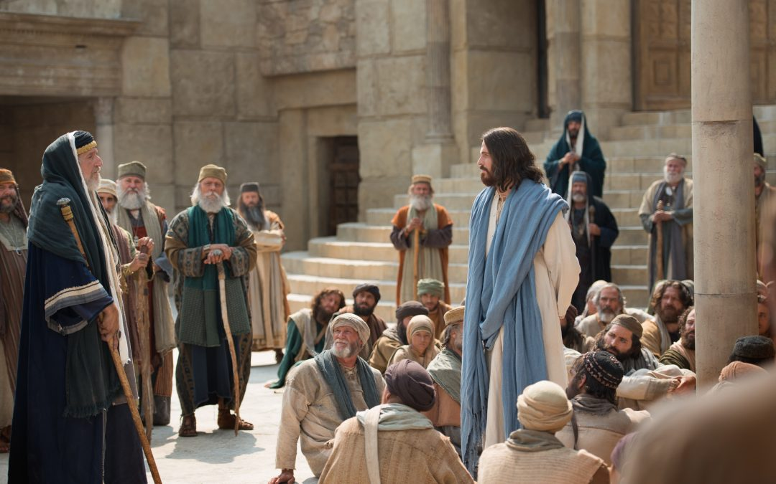
Notes:
Mar 12:28-34 Then one of the scribes came, and having heard them reasoning together, perceiving that He had answered them well, asked Him, "Which is the first commandment of all?" (29) Jesus answered him, "The first of all the commandments is: 'HEAR, O ISRAEL, THE LORD OUR GOD, THE LORD IS ONE. (30) AND YOU SHALL LOVE THE LORD YOUR GOD WITH ALL YOUR HEART, WITH ALL YOUR SOUL, WITH ALL YOUR MIND, AND WITH ALL YOUR STRENGTH.' This is the first commandment. (31) And the second, like it, is this: 'YOU SHALL LOVE YOUR NEIGHBOR AS YOURSELF.' There is no other commandment greater than these." (32) So the scribe said to Him, "Well said, Teacher. You have spoken the truth, for there is one God, and there is no other but He. (33) And to love Him with all the heart, with all the understanding, with all the soul, and with all the strength, and to love one's neighbor as oneself, is more than all the whole burnt offerings and sacrifices." (34) Now when Jesus saw that he answered wisely, He said to him, "You are not far from the kingdom of God." But after that no one dared question Him.

Slide 14
What is Integrity?
(Mark 12:29-31) Jesus answered him, "The first of all the commandments is: 'HEAR, O ISRAEL, THE LORD OUR GOD, THE LORD IS ONE. AND YOU SHALL LOVE THE LORD YOUR GOD WITH ALL YOUR HEART, WITH ALL YOUR SOUL, WITH ALL YOUR MIND, AND WITH ALL YOUR STRENGTH.' This is the first commandment. And the second, like it, is this: 'YOU SHALL LOVE YOUR NEIGHBOR AS YOURSELF.' There is no other commandment greater than these."

Slide 15
How do we love God?

Slide 16
Loving God
Trust in God
Submission to God’s will, willingly
Notes:
Gen 2:16-17 And the LORD God commanded the man, saying, "Of every tree of the garden you may freely eat; (17) but of the tree of the knowledge of good and evil you shall not eat, for in the day that you eat of it you shall surely die."
Joh 6:28-29 Then they said to Him, "What shall we do, that we may work the works of God?" (29) Jesus answered and said to them, "This is the work of God, that you believe in Him whom He sent."
Mat 7:21 "Not everyone who says to Me, 'Lord, Lord,' shall enter the kingdom of heaven, but he who does the will of My Father in heaven.

Slide 17
Spiritual Man
Holy Spirit / Matter
Heart
Soul
Mind
Strength
The Self
Worldview
Intentions
Potentials
Notes:
1Ch 28:9 "As for you, my son Solomon, know the God of your father, and serve Him with a loyal heart and with a willing mind; for the LORD searches all hearts and understands all the intent of the thoughts. If you seek Him, He will be found by you; but if you forsake Him, He will cast you off forever.
Gen 2:7 And the LORD God formed man of the dust of the ground, and breathed into his nostrils the breath of life; and man became a living being. Job 33:4
Rom 8:5-7 For those who live according to the flesh set their minds on the things of the flesh, but those who live according to the Spirit, the things of the Spirit. (6) For to be carnally minded is death, but to be spiritually minded is life and peace. (7) Because the carnal mind is enmity against God; for it is not subject to the law of God, nor indeed can be.
Rom 12:1 I beseech you therefore, brethren, by the mercies of God, that you present your bodies a living sacrifice, holy, acceptable to God, which is your reasonable service.
Rom 8:9 But you are not in the flesh but in the Spirit, if indeed the Spirit of God dwells in you. Now if anyone does not have the Spirit of Christ, he is not His.

Slide 18
WHY is Integrity important in evangelism?

Slide 19
World Evangelisation
But perhaps the greatest hindrance to world evangelization remains our failure to be what we profess to be. The covenant still challenges us to look like what we are talking about: "Nothing commends the Gospel more eloquently than a transformed life, and nothing brings it into disrepute so much as personal inconsistency"
- Manila Manifesto

Slide 20

We stand before God

Slide 21

Paul’s life journey
1 Cor 15:9 “ I am the least of the Apostles ” AD 56
Eph 3:8 “ Least of all Saints ” AD 60
1 Tim 1:15 “ Chief of all Sinners ” AD 64
The closer Paul came to God, he acknowledged himself as ‘nothing’
Notes:
1Ti 1:15-16 This is a faithful saying and worthy of all acceptance, that Christ Jesus came into the world to save sinners, of whom I am chief. (16) However, for this reason I obtained mercy, that in me first Jesus Christ might show all longsuffering, as a pattern to those who are going to believe on Him for everlasting life.

Slide 22

You are not just the messenger, but you are the message for the gospel

Slide 23


